Slide 1
Harmonic Drive Actuator
Shad Gitiforooz
March 2024

Slide 2
Assumptions
Minimize weight and size whenever possible.
The output shaft must support radial and axial forces.
No cooling or brake system required.
Optimize for heavy loading/ low speeds.
Controller and encoder output electronics can be combined into 1 PCB.

Slide 3
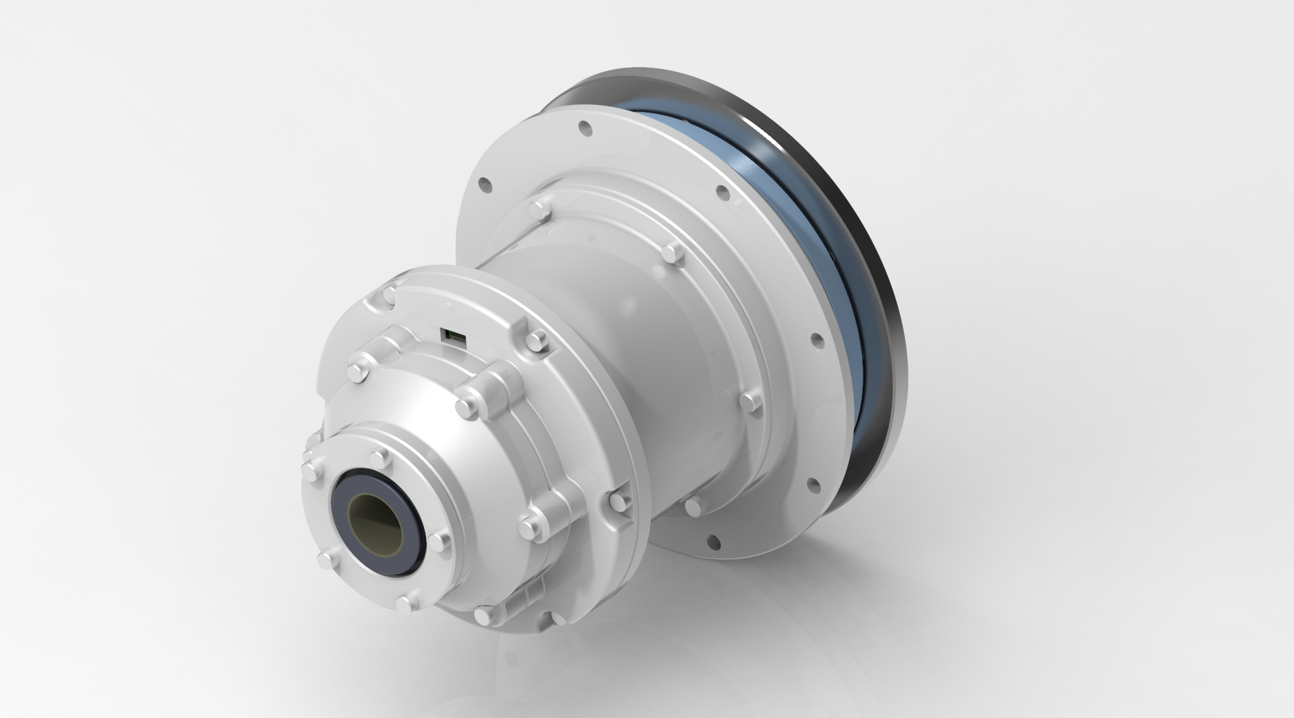

Slide 4
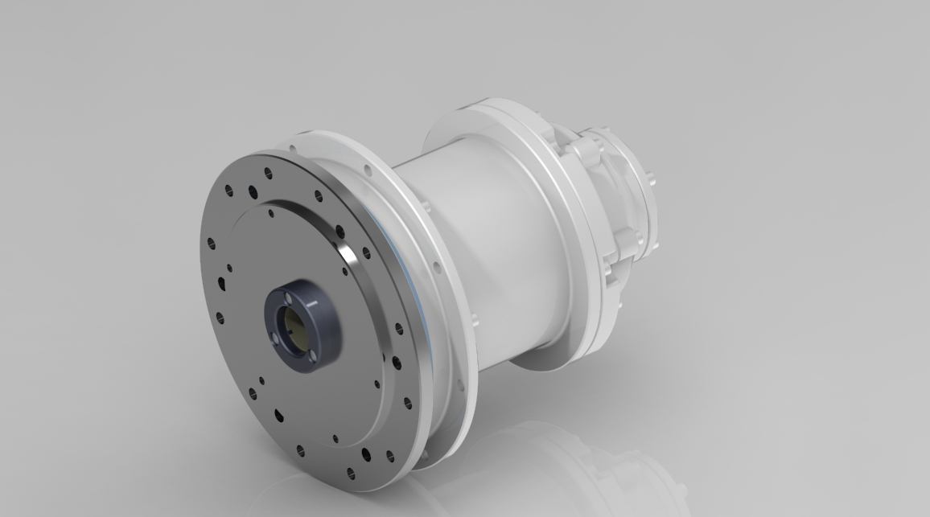

Slide 5
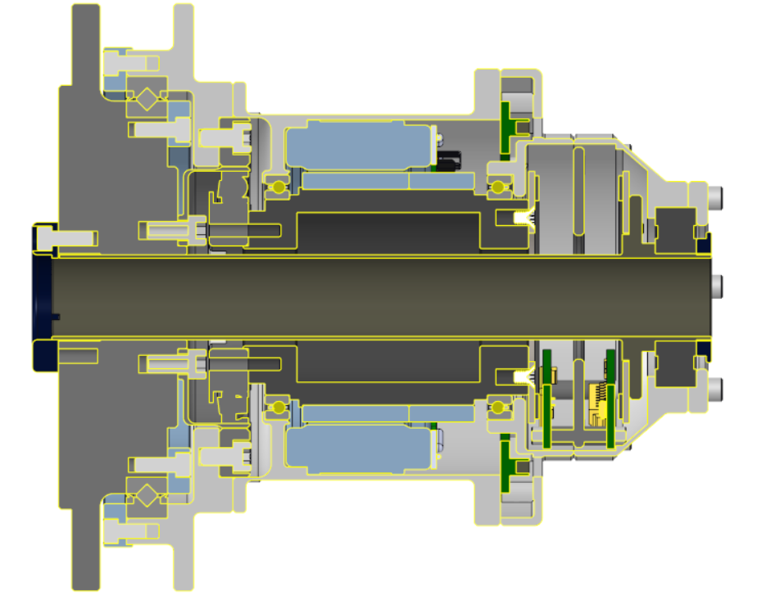
Motor Driver

Slide 6
Parts Sourced (excluding hardware)
Input Shaft Ball Bearings (2x): KDN.SAA15CL0
Output Shaft Bearings: CRBS708VUU
Hollow Shaft Ball Bearing: 16003ZZCM

Slide 7
Notes
Add slotted Disk Spring to preload bearings
Accommodate for tolerance stackup
Reduce Vibration
Avoid Shaft deflection
Reduce Noise
Pick new end bearing
Sealed, not pre-lubricated
Add some material on housing parts to provide more support
Remove material on housing parts to reduce weight

Slide 8
Input Shaft Ball Bearings (2x): KDN.SAA15CL0
Accommodates radial loads
Did not deem axial loads as necessary
Wanted to keep things cheap for this part
Thus decided on Radial contact ball bearing (type C)
Stainless Steel
Corrosion resistant
High strength and hardness - will have to endure high impulse during launch
Higher temperature range - optimal for space
No sealing - not needed on interior of actuator
No lubricant
Space is a vacuum and cold. This can affect lubricant physical properties
Loads should not strain the bearings too much - should be fine without lubricant
Slim profile ideal for recreating actuator assigned

Slide 9
Output Shaft Bearings: CRBS708VUU
Accommodates radial and axial loads
Actuator will need to support axial loads at this interface
Crossed Roller bearings
Cage and Separator - ideal for low speeds/ high loads
Stainless Steel
Corrosion resistant
High strength and hardness - will have to endure high impulse during launch
Higher temperature range - optimal for space
Lubricant will be needed -
Low vapor pressure required to withstand vacuum
Perfluoropolyethers, cyclopentanes and polyalphaolefins
Slim profile ideal for recreating actuator assigned and minimize weight

Slide 10
Hollow Shaft Ball Bearing: 16003ZZCM
Accommodates radial loads
Axial load supports will not be necessary at this end
Thus decided on Radial contact ball bearing (type C)
Inexpensive part
Very thin - ideal for the limited space
Chrome steel
Enhanced corrosion resistance
High strength and hardness - will have to endure high impulse during launch
Lower temperature range than stainless, but still good
Not sealed - should be sealed in space. May need a different bearing
Pre-lubricated - might outgas in space. May need different bearing
Slim profile ideal for recreating actuator assigned

Slide 11
Middle

Slide 12
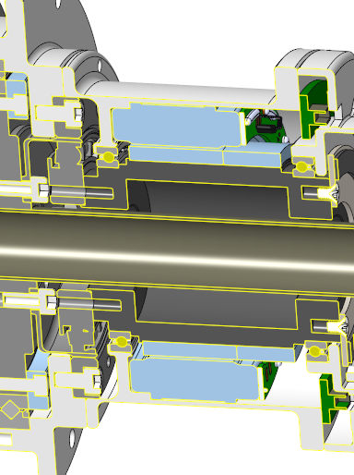
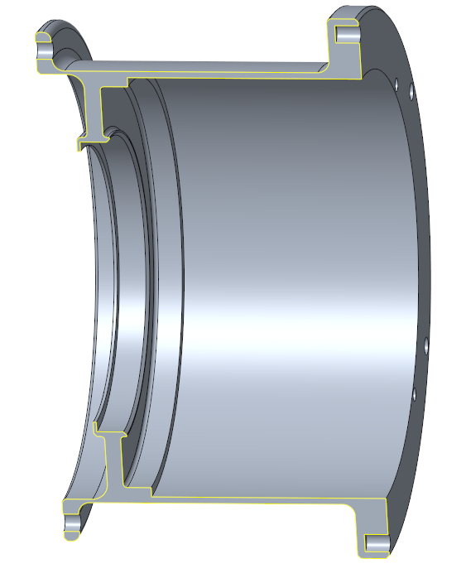
Housing - Middle
Mating:
To Housing lower: .100” Flange w/ 6x #4 holes
To stator: Shelf for stator to sit on
.002” distance between housing ID and stator OD
Loctite RC-640 to bond stator in place
Shelf for bearings to sit
Interference fit + Loctite RC-640
To Housing upper: .200” Flange w/ 6x #4 holes
To controller: 4x #2 tapped holes
Thickness: .040”
Material: Aluminum 6061
Ways to improve:
Add material here
Increase thickness of lower flange

Slide 13
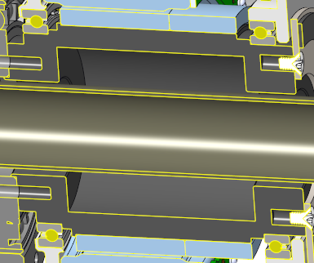
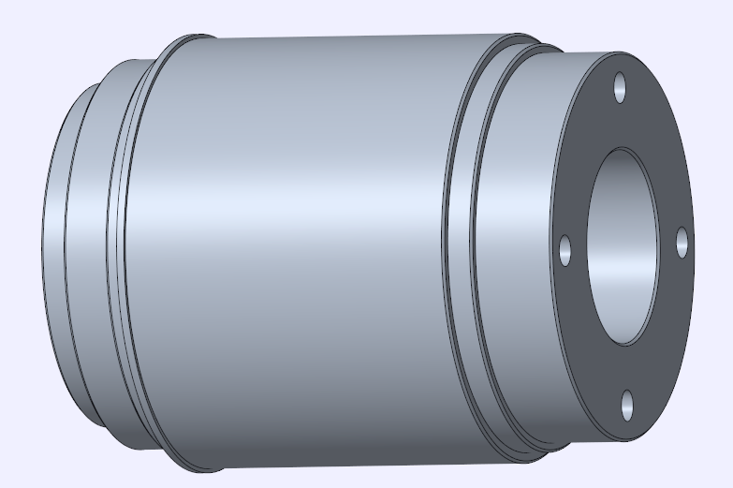
Input Shaft
Mating:
To bearings and stator: Flanges for positioning (green)
Loctite RC-640 to bond
To reduction gear: 4x #6 tapped holes & 4 align holes
Added flange to position gear during assembly
To encoder disk: 4x M2.5
Hollowed interior to reduce weight
Material: 303 Stainless
Shaft must be strong and stiff to resist deformation
Deformation can cause downstream runnout issues
Strength of SS is not necessary
Manufacturing: CNC Lathe w/ recessed tool to hollow interior

Slide 14
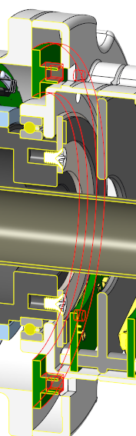
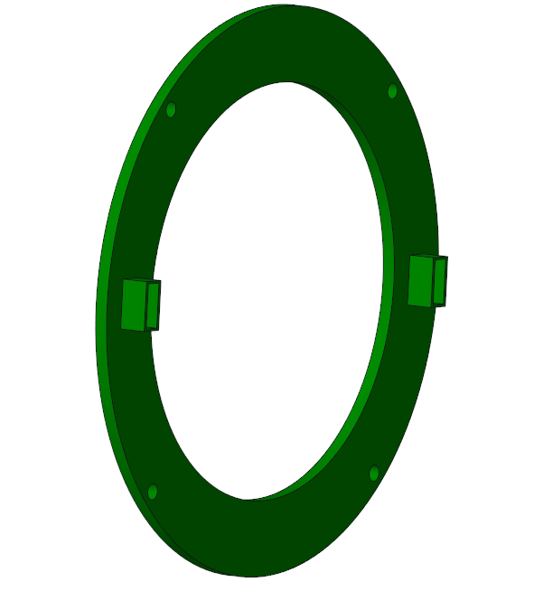
Controller
Placeholder, can be modified per requirements given by EE team
OD: 3.000”
ID: 2.200” (Can be decreased)
Mating:
To housing: 4x #2 tapped holes
Blue Loctite 444
Assumed the controller and encoder PCBs could be combined on 1 bigger PCB
This allows a reducing diameter on the upper end of the actuator
Ways to improve:
Can we combine 2 motor driver connectors into 1?

Slide 15
Housing - Upper 1

Slide 16
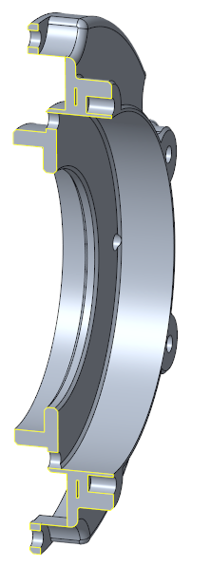
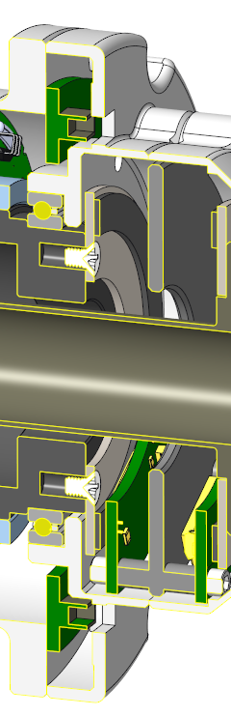
Housing - Upper 1
Mating:
To Bearing: shelf - bond with Loctite RC-640
To Housing-Middle: 6x #4 screws
Cut-out inside diameter for mounting to minimize weight
To Housing Upper 2 - tapped holes 6x #4 holes on the exterior of the housing
Design Features:
Space between encoder disk and housing
Holes to route cables from encoder boards
.8mm between disk and readhead
Material: Aluminum 6061
Ways to improve:
Fix shell feature defect here

Slide 17
Housing - Upper 2

Slide 18
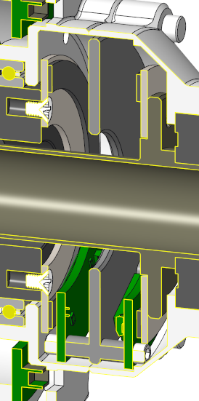
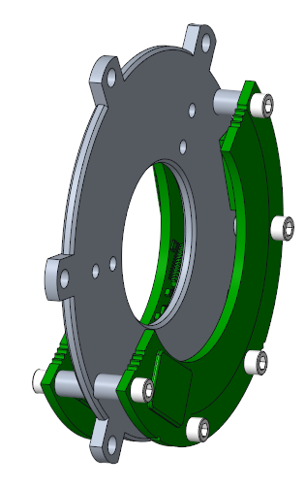
Encoder Readhead Assembly
Mating:
To Encoder Readhead: boss with 5x #2 tapped holes
To Housing-Upper: 6x holes that will sit on the housing - upper 1 bosses
External to inside diameter to minimize weight
In order to minimize diameter
Readheads define limits of housing
Design Features:
Space between encoder disk and housing
Holes to route cables from encoder boards
Material: Aluminum 6061
Ways to improve:
Way to center the readheads - alignment pin holes
Notes:
NOTE: how to ensure this will be concentric to the encoder disk.

Slide 19
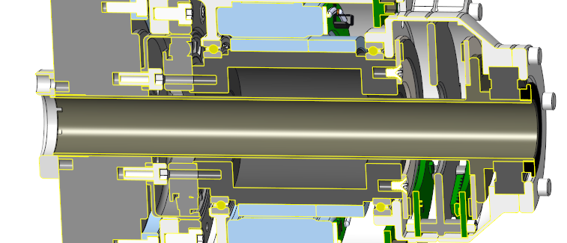
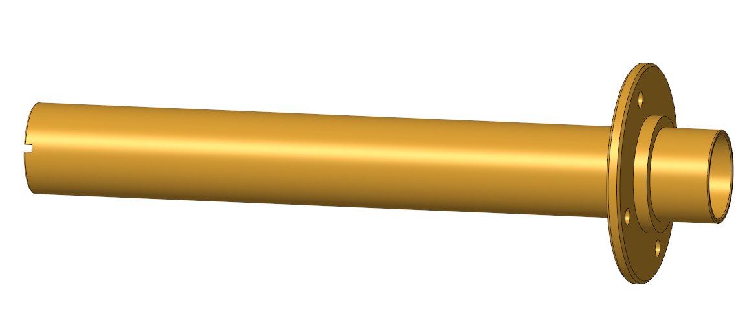
Hollow Shaft
Purpose:
Provide hollow shaft to route cables
Mate to Output Shaft
Mate to encoder disk 2 (measure output)
Mating:
To encoder disk: 4x M2.5
To output shaft:
Interference Fit: Loctite RC-640
3x #4 holes
To Bottom Cap:
Interference Fit: 3x #4
3x teeth to support torsional loads
To Upper Cap:
Press fit (-0.004” if aluminum)
Notes:
NOTE: how to ensure this will be concentric to the encoder disk.

Slide 20
Hollow Shaft
Design Features:
Do not contact Input Shaft
3x teeth at bottom end to support torsional loads
Shelf for upper bearing to contact
Flange to secure encoder disk
Material: Aluminum 6061
Want good torsional strength
Notes:
Manufacture with CNC Lathe
Notes:
NOTE: how to ensure this will be concentric to the encoder disk.

Slide 21
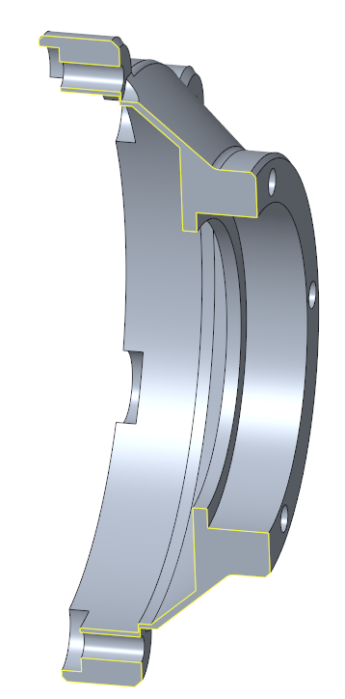
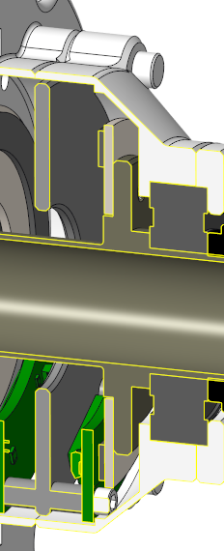
Housing Upper 2
Mating:
6x #4 holes on exterior
Space left for encoder readhead assembly to mount (pink)
Flange to position bearing (Green)
Interference Fit / Loctite RC-640
Top Bearing Retainer: 6x #4 tapped holes
Material: Aluminum 6061
Ways to improve:
Reduce Material for mounting interface (orange)
Notes:
NOTE: how to ensure this will be concentric to the encoder disk.

Slide 22
Bearing Cap

Slide 23
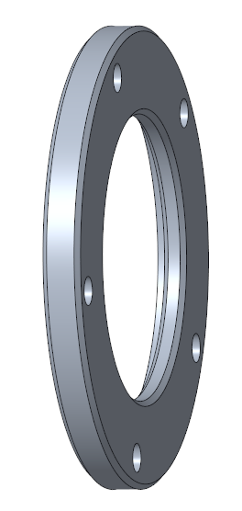
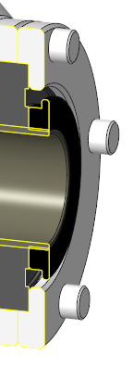
Top Bearing Retainer
Mating:
Flange to position onto bearing
To Upper Housing 2: 5x #4 holes
Purpose:
Hold upper bearing in place
Material: Aluminum 6061
Notes:
NOTE: how to ensure this will be concentric to the encoder disk.

Slide 24
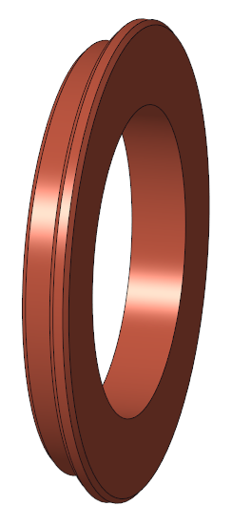
Inner Shaft Cap - Upper
Purpose:
Additional support for top bearing
Nice Finish
Mating:
Press fit (-0.004” if aluminum)
Material: Aluminum 6061/ Polymer
Notes:
NOTE: how to ensure this will be concentric to the encoder disk.

Slide 25
Lower 1

Slide 26
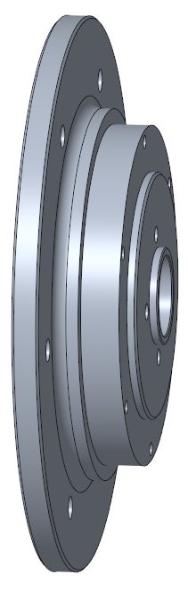
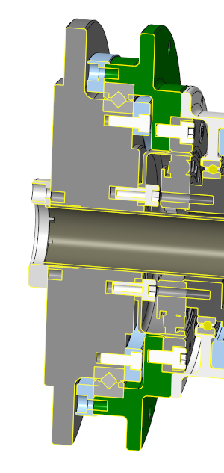
Output Shaft
Purpose:
Interface to mount to
Mount to hollow shaft - to link to encoder
Mount to cross roller bearing
Mount to Reduction Gear - FlexSpline
Mating:
To Hollow Shaft Cap: 3 screws
To Inner Shaft: Interference Fit w/ Loctite RC-640
Holes for Bearing Retainer Upper
Bearing: Interference fit with Bearing + Loctite
Flexspline: tapped holes #6
Notes:
NOTE: how to ensure this will be concentric to the encoder disk.

Slide 27
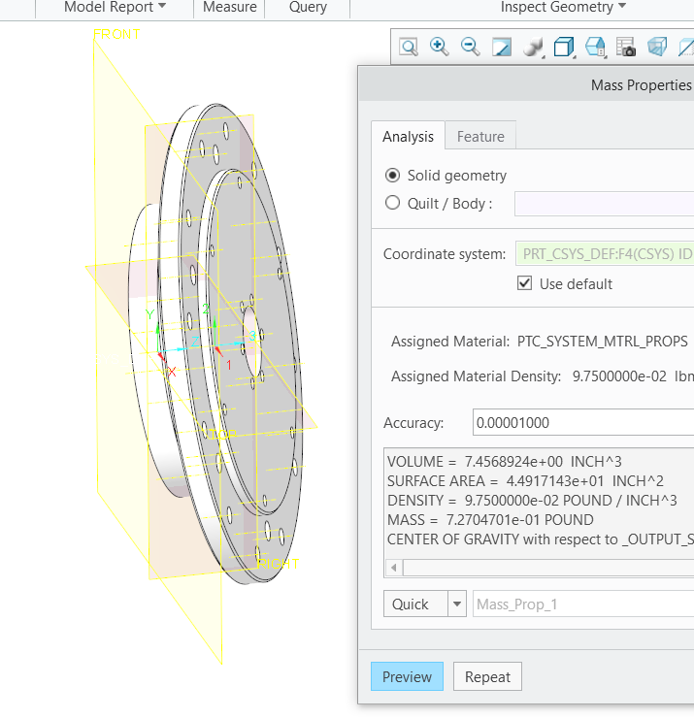
Output Shaft
Design Features:
Flanges or shelves to position/ center
For press fit: hole is +0.001” +- .0005”
Material: Aluminum 6061
Notes:
NOTE: how to ensure this will be concentric to the encoder disk.

Slide 28
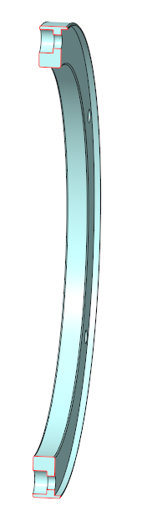
Bearing Retainers
Purpose: Secure Bearings to Output shaft
Mating:
6x #4 holes
Design Features:
Flange on outside brim to position on Housing
Material: Aluminum 6061
Notes:
NOTE: how to ensure this will be concentric to the encoder disk.

Slide 29
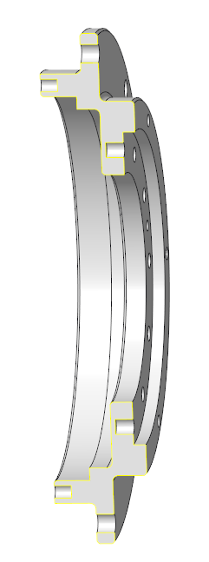
Housing - Bottom
Purpose:
Enclose gear and bottom of assembly
Position Bearing
External mounting points
Mating:
To RG - Circular Spline: Dowel Pin slip fit holes
To Housing-Mid: #4 tapped holes
Design Features:
External Mounting holes: #8
Material: Aluminum 6061
Notes:
NOTE: how to ensure this will be concentric to the encoder disk.

Slide 30
Assembly Procedure

Slide 31
Middle
Housing
Loctite RC-640/ Slip Fit
Bearing 1
Motor + Input Shaft
+.00
Bearing 2
Controller

Slide 32
2) Upper 1
Housing
Encoder Disk 1
Encoder Readhead Assembly
Inner Shaft + Encoder Disk 2

Slide 33
3) Upper 2
Housing
Bearing
Bearing Retainer
Inner Shaft Cap Ring

Slide 34
4) Bottom
RG - Wave Generator to Input Shaft (dowel pin)
----------------
Output Shaft
Cross Bearing
Bearing Retainer Ring Upper
Bearing Retainer Ring Bottom
Housing Bottom (dowel pin)
RG - Flexspline to Output Shaft
RG - Circular Spline to Housing
-------
Assemble Reduction Gear

